Slide 1


Interfacing Memory with 8086
Presented by
Mahbubur Rahman
Lecturer
Department of Computer Science and Engineering(CSE)
Green University of Bangladesh(GUB)

Slide 2
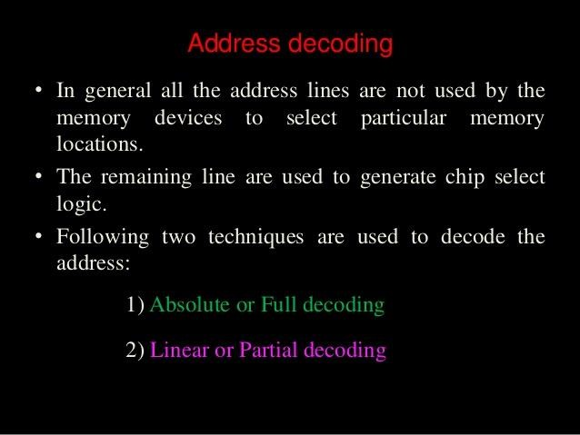

Slide 3
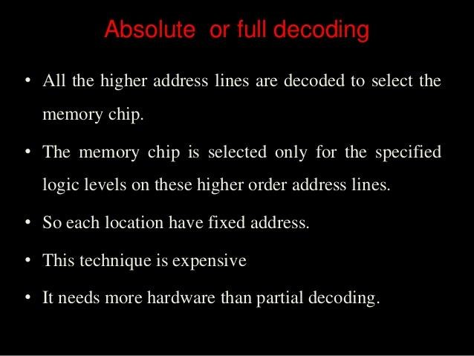

Slide 4
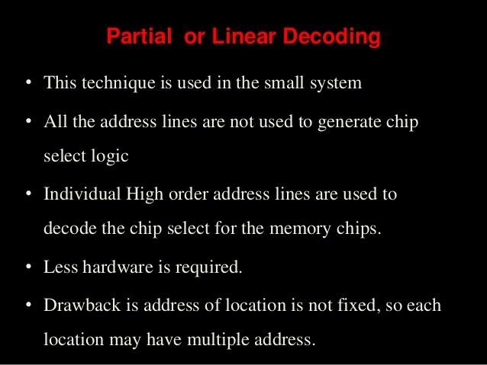

Slide 5
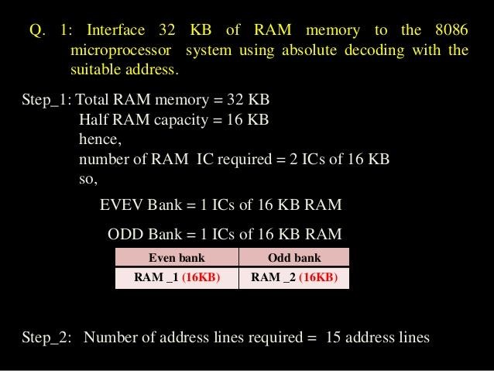


Slide 6
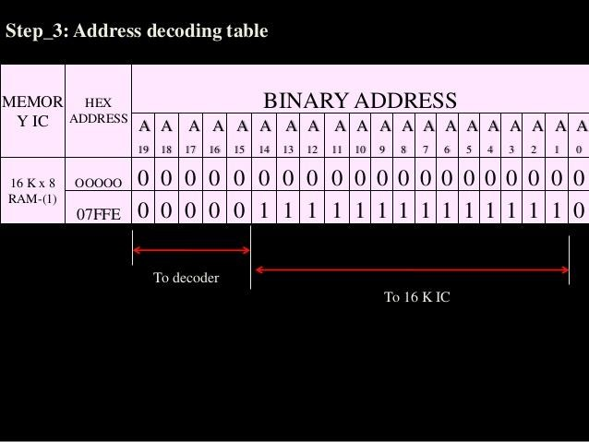



Slide 7
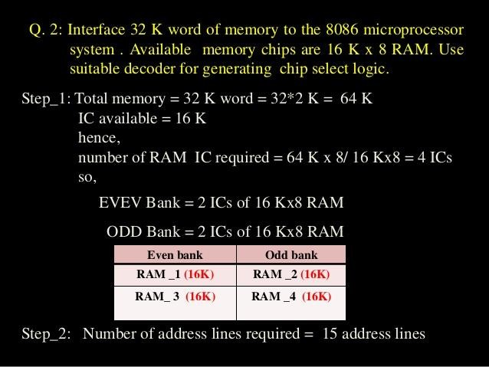


Slide 8
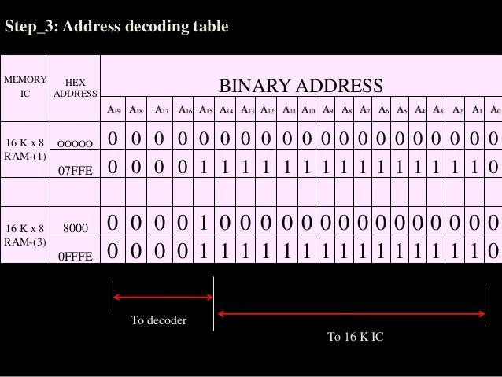

Slide 9
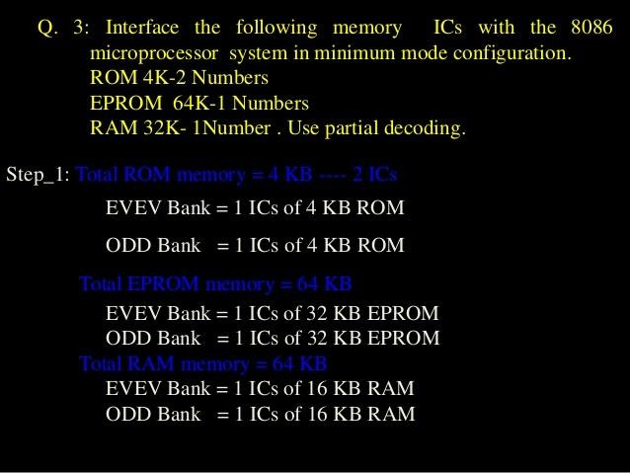



Slide 10
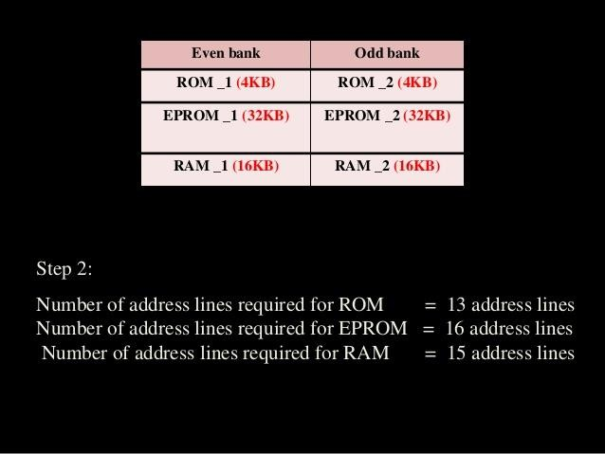

Slide 11
